Slide 1



Bryan Cafferky
Microsoft Technology Solutions Professional
Two Time Microsoft MVP
Decades of IT experience
Author of Pro PowerShell for Database Developers by Apress
SQL PASS Chapter Lead
Lead the Greater Boston Data Science, ML , and AI Group
@bryancafferky
Bryan.Cafferky@Microsoft.com
https://www.youtube.com/user/Bryancutube256123

Slide 2
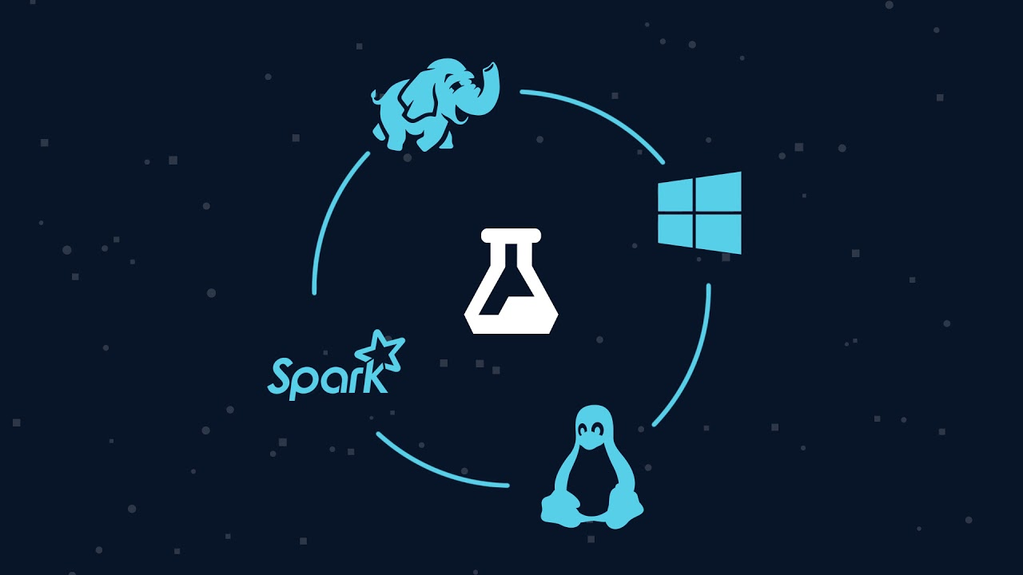
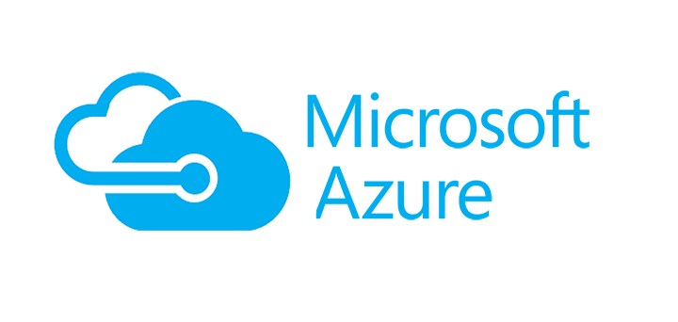

Azure Data Services Overview
Bryan Cafferky
Technical Solutions Professional

Slide 3

Why So Many Options?

Slide 4

Why So Many Options?
https://www.quebechebdo.com/content/dam/tc/quebec-hebdo/images/2010/7/16/une-nouvelle-salle-d-operation-pour-cont-1075320.jpg

Slide 5

Data Science, ML, and AI Perspective

Slide 6
Use Cases
Readmissions
Patient Risks like Infection, Cardiac Arrest, Pulmonary Distress
Patient Managed Care – Risks and Prevention
Customer Patient Analytics Portal
Sentiment Analysis

Slide 7
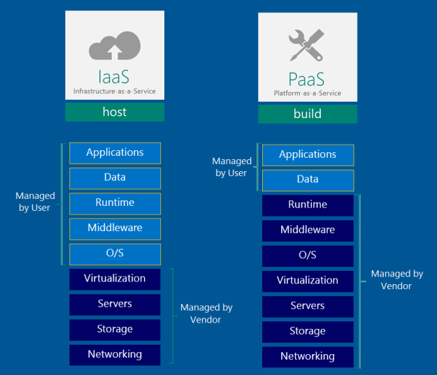
Azure Data Platform

Slide 8

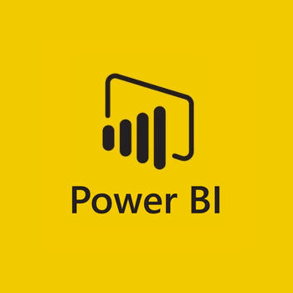
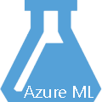

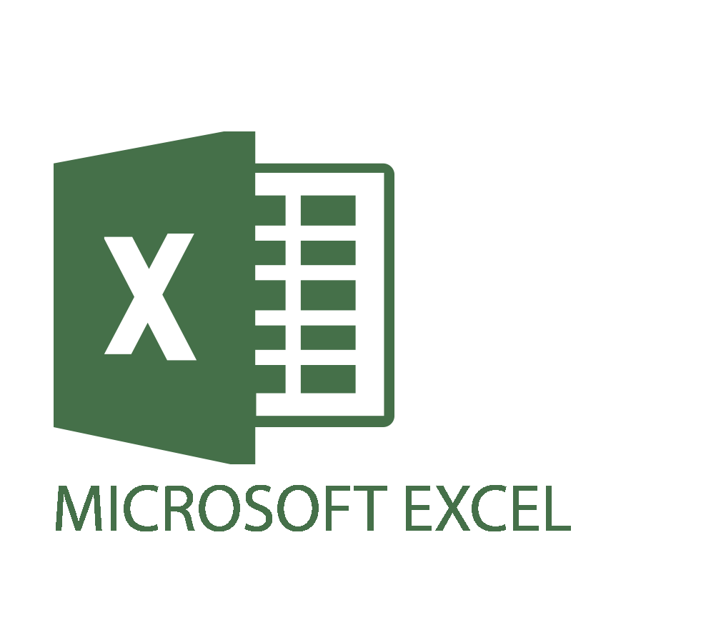


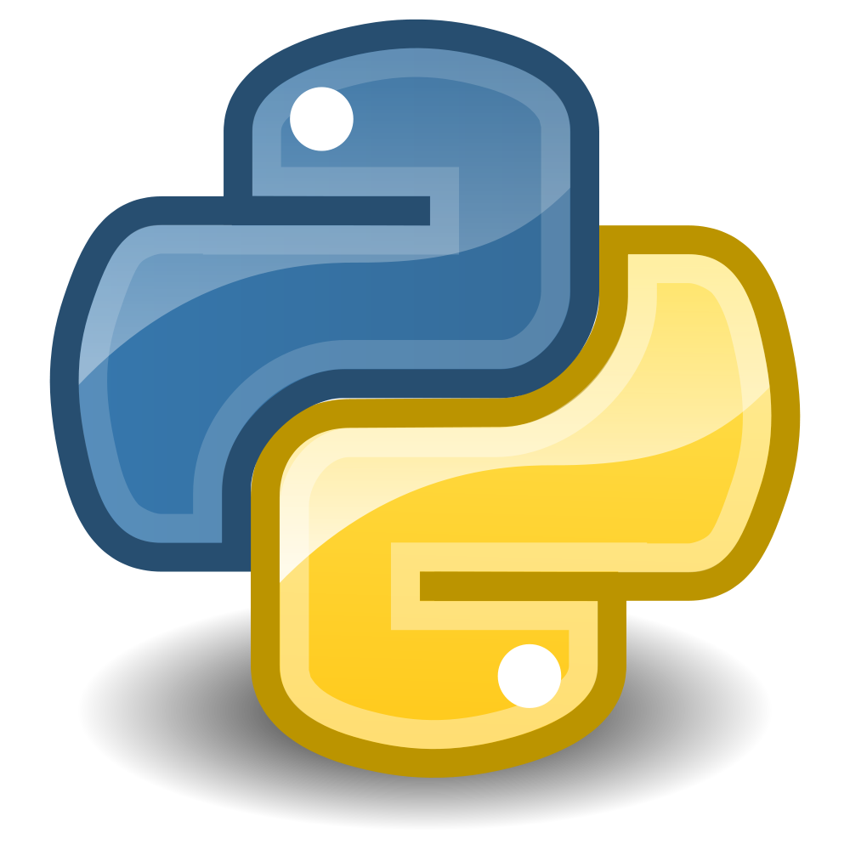

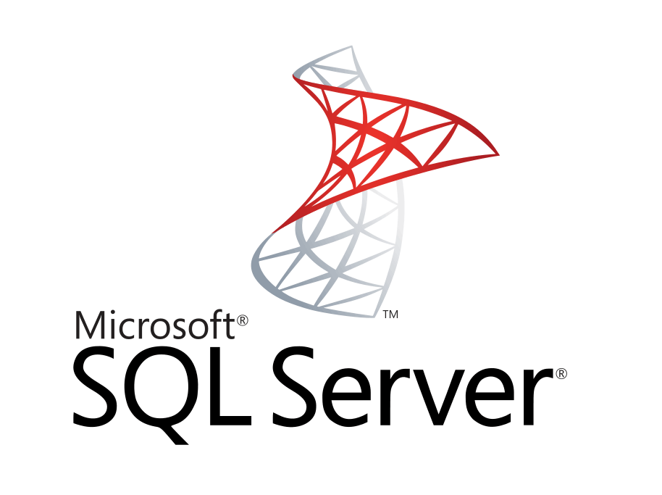


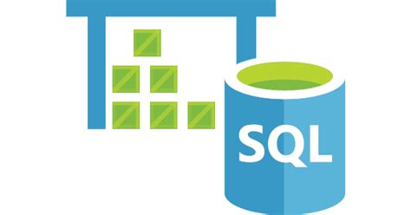
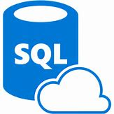



Data Analysis Platform
Client Tools
ML Workbench
Streaming
Azure Data Factory
Data Ingestion
On-Prem
GA 3/2018
Analysis Services
Data Lake
Analytics
SQL Data Warehouse
Managed Instance/
SQL DB
Cosmos DB
HDInsight
Databricks
Massively Parallel Processing
* Planned
PostgreSQL and MySQL Offered as Azure Services (in preview).
Scale

Slide 9
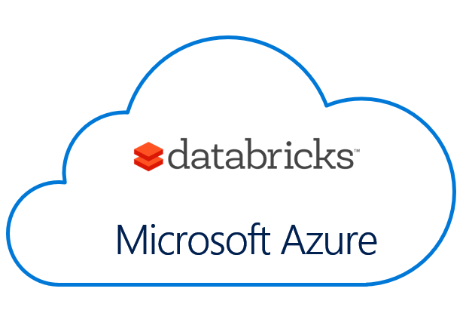
An Introduction to Azure Databricks Bryan Cafferky Technical Solutions Professional
Global Boot Camp:
https://bostonazurebootcamp.com/2018
GitHub:
https://github.com/bcafferky/shared

Slide 10
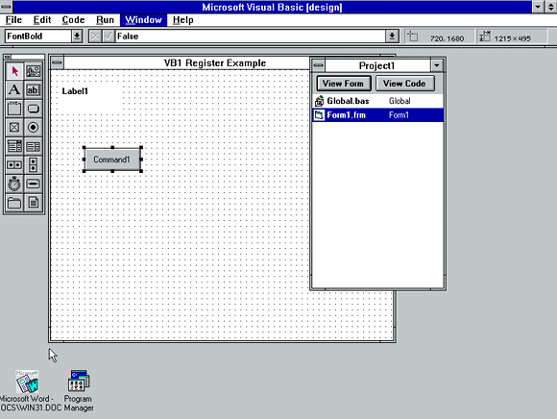
Making Things Easier

Slide 11
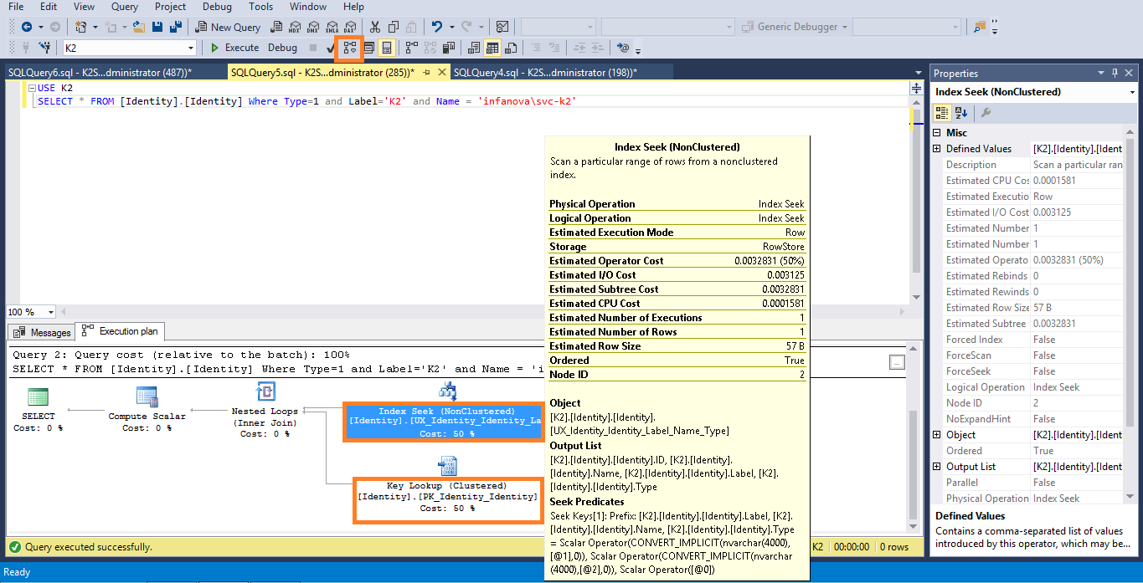
Making Things Easier

Slide 12




Azure
First Class
Big Data
Easy
Cluster Creation
Scheduling
+
Notebooks
Security
Collaboration
Machine Learning

Slide 13
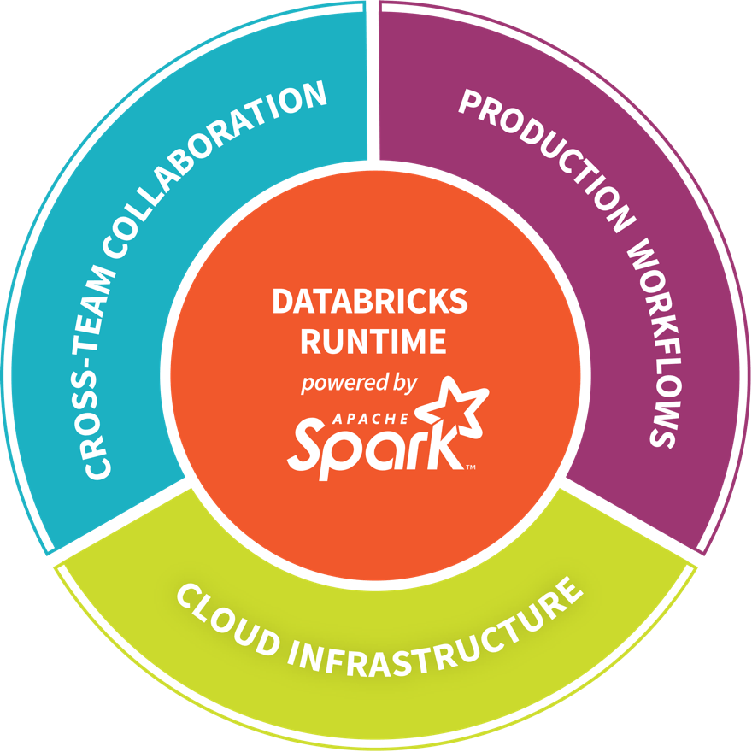
Databricks - Company Overview
Founded in late 2013
By the creators of Apache Spark, original team from UC Berkeley AMPLab
Largest code contributor code to Apache Spark
Level 2/3 support partnership with
Hortonworks
MapR
DataStax
Provides certifications such as Databricks Certified Application, Databricks Certified Distribution and Databricks Certified Developer
Main Product: The Unified Analytics Platform
In Oct 2017, introduced Databricks Delta (currently in private preview).

Slide 14

Azure Databricks
Azure Databricks is a first party service on Azure.
Unlike with other clouds, it is not an Azure Marketplace or a 3rd party hosted service.
Azure Databricks is integrated seamlessly with Azure services:
Azure Portal: Service an be launched directly from Azure Portal
Azure Storage Services: Directly access data in Azure Blob Storage and Azure Data Lake Store
Azure Active Directory: For user authentication, eliminating the need to maintain two separate sets of uses in Databricks and Azure.
Azure SQL DW and Azure Cosmos DB: Enables you to combine structured and unstructured data for analytics
Apache Kafka for HDInsight: Enables you to use Kafka as a streaming data source or sink
Azure Billing: You get a single bill from Azure
Azure Power BI: For rich data visualization
Eliminates need to create a separate account with Databricks.
Microsoft Azure

Slide 15

Jumpstart with Sample Notebooks
https://clipartion.com/free-clipart-12075/

Slide 16
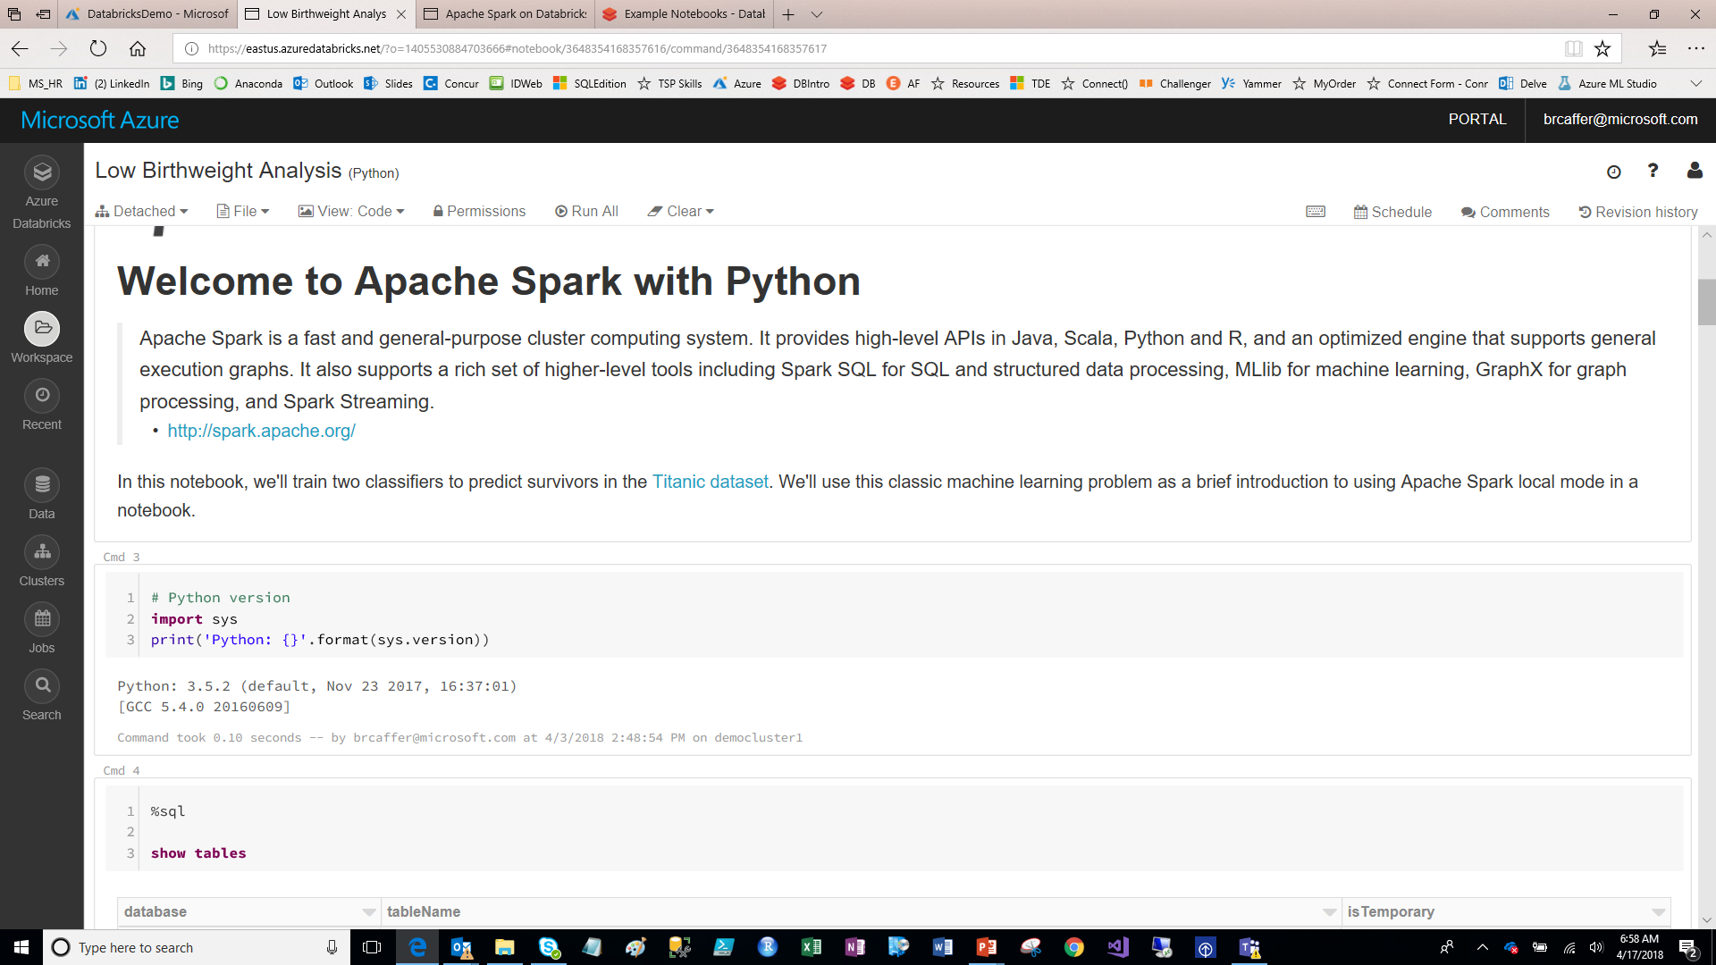
Azure Databrick Notebooks
Toolbar
Annotations
Code Cells

Slide 17
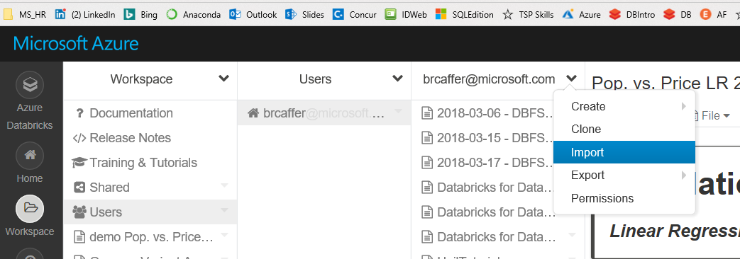
Importing Notebooks
Under Workspace/Users/User – Select Import from the Dropdown

Slide 18
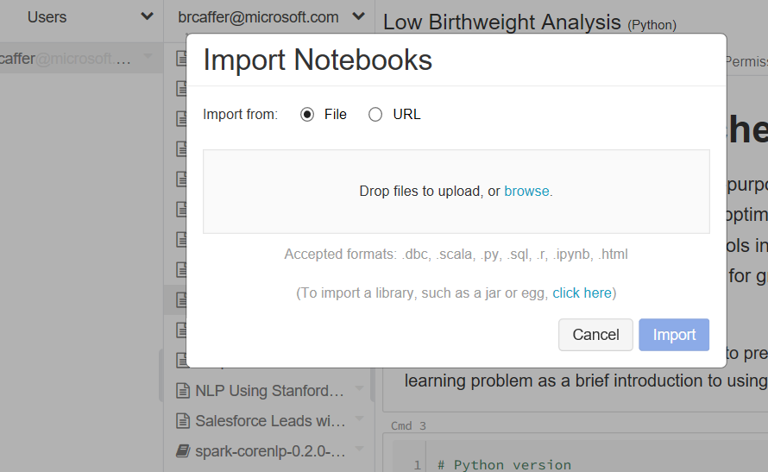
Importing Notebooks
From file or URL
Import library

Slide 19
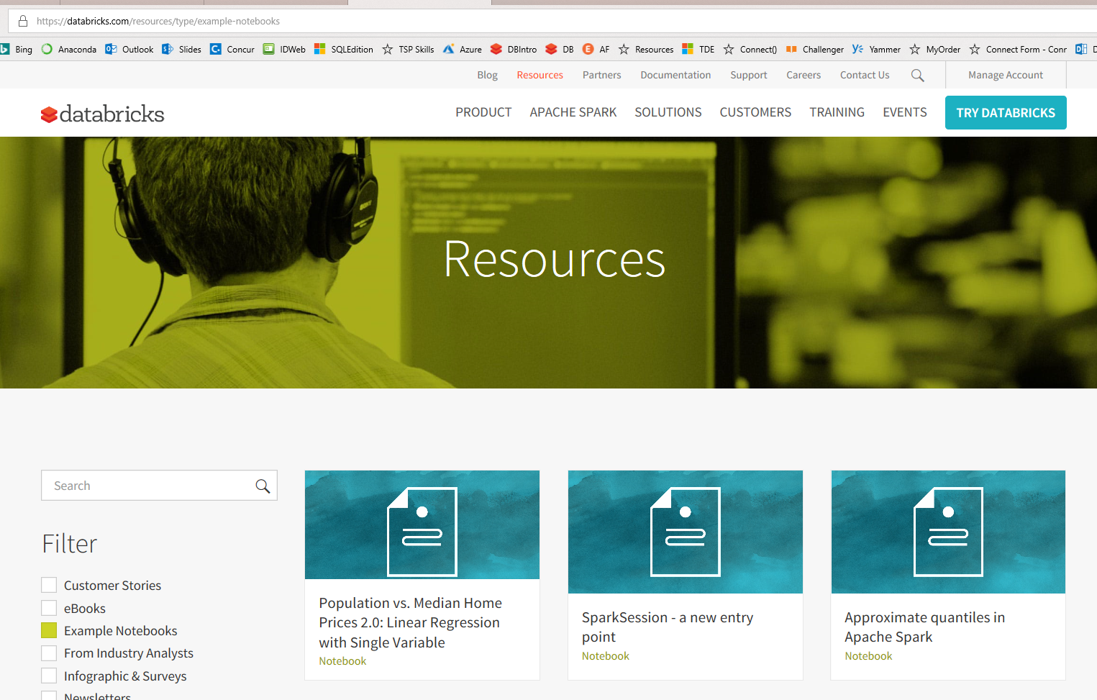
Importing Notebooks
Lot of sample notebooks to try
https://databricks.com/resources/type/example-notebooks

Slide 20
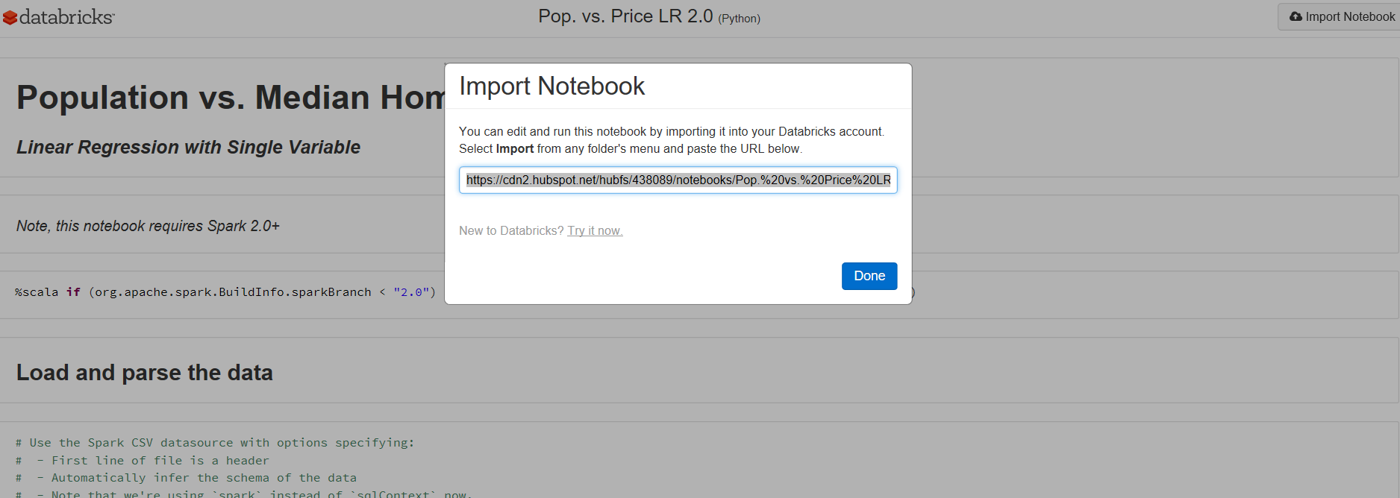
Importing Notebooks
Open and Click on the Import Notebook Button
Copy the Link to the Clipboard
https://databricks.com/resources/type/example-notebooks

Slide 21
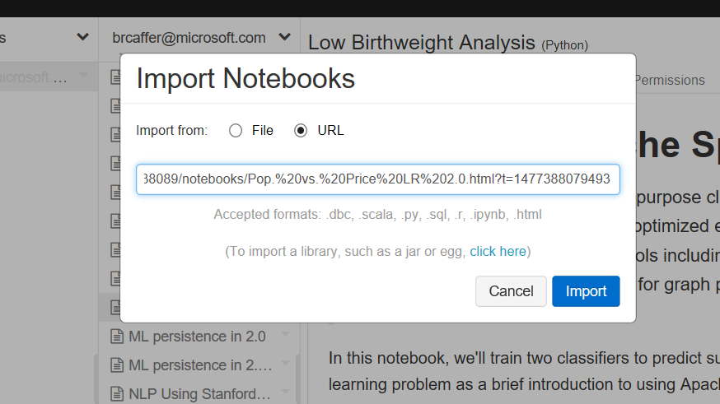
Importing Notebooks
Paste the Link and Click Import
https://databricks.com/resources/type/example-notebooks

Slide 22
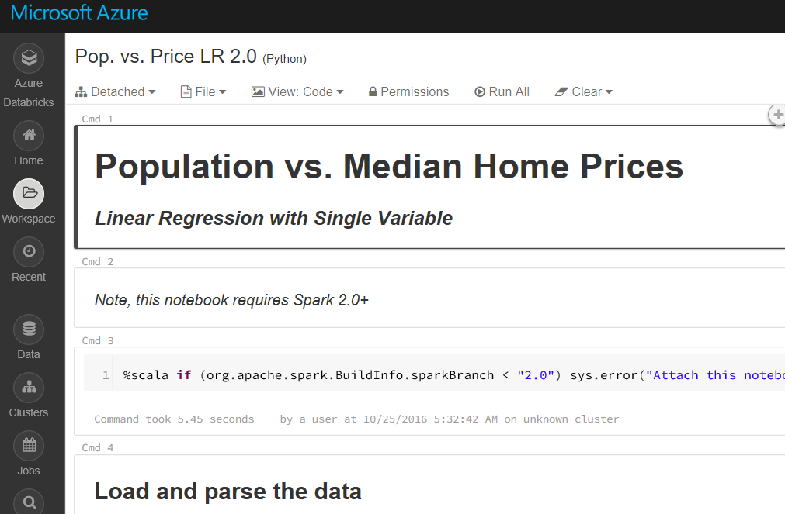
Importing Notebooks
Imported Notebook
https://databricks.com/resources/type/example-notebooks

Slide 23

Why Spark?
Open-source data processing engine built around speed, ease of use, and sophisticated analytics
In memory engine that is up to 100 times faster than Hadoop
Largest open-source data project with 1000+ contributors
Highly extensible with support for Scala, Java and Python alongside Spark SQL, GraphX, Streaming and Machine Learning Library (Mllib)
Notes:
When it comes to ease of use, Spark again happens to be a lot better than Hadoop. Spark has APIs for several languages such as Scala, Java and Python, besides having the likes of Spark SQL. It is relatively simple to write user-defined functions. It also happens to boast an interactive mode for running commands. Hadoop, on the other hand, is written in Java and has earned the reputation of being pretty difficult to program, although it does have tools that assist in the process. (To learn more about Spark, see How Apache Spark Helps Rapid Application Development.)
In-Memory Technology
One of the unique aspects of Apache Spark is its unique "in-memory" technology that allows it to be an extremely good data processing system. In this technology, Spark loads all of the data to the internal memory of the system and then unloads it on the disk later. This way, a user can save a part of the processed data on the internal memory and leave the remaining on the disk.
Spark also has an innate ability to load necessary information to its core with the help of its machine learningalgorithms. This allows it to be extremely fast.
Spark’s Core
Spark’s core manages several important functions like setting tasks and interactions as well as producing input/output operations. It can be said to be an RDD, or resilient distributed dataset. Basically, this happens to be a mix of data that is spread across several machines connected via a network. The transformation of this data is created by a four-step method, comprised of mapping the data, sorting it, reducing it and then finally, joining the data.
Following this step is the release of the RDD, which is done with support from an API. This API is a union of three languages: Scala, Java and Python.
Spark’s SQL
Apache Spark’s SQL has a relatively new data management solution called SchemaRDD. This allows the arrangement of data into many levels and can also query data via a specific language.
Graphx Service
Apache Spark comes with the ability to process graphs or even information that is graphical in nature, thus enabling the easy analysis with a lot of precision.
Streaming
This is a prime part of Spark that allows it to stream large chunks of data with help from the core. It does so by breaking the large data into smaller packets and then transforming them, thereby accelerating the creation of the RDD.
MLib – Machine Learning Library
Apache Spark has the MLib, which is a framework meant for structured machine learning. It is also predominantly faster in implementation than Hadoop. MLib is also capable of solving several problems, such as statistical reading, data sampling and premise testing, to name a few.

Slide 24
Apache Spark
An unified, open source, parallel, data processing framework for Big Data Analytics
Spark SQL
Interactive Queries
Spark MLlib
Machine Learning
Spark Streaming
Stream processing
GraphX
Graph Computation
Spark Unifies:
Batch Processing
Interactive SQL
Real-time processing
Machine Learning
Deep Learning
Graph Processing
Spark Core Engine
Yarn
Mesos
Standalone Scheduler
Spark MLlib
Machine Learning
Spark Structured Streaming
Stream processing

Slide 25



Azure Databricks
Azure Databricks
Collaborative Workspace
IoT / streaming data
Machine learning models
DATA ENGINEER
DATA SCIENTIST
BUSINESS ANALYST
Deploy Production Jobs & Workflows
Cloud storage
BI tools
MULTI-STAGE PIPELINES
JOB SCHEDULER
NOTIFICATION & LOGS
Data warehouses
Optimized Databricks Runtime Engine
Data exports
Hadoop storage
DATABRICKS I/O
APACHE SPARK
SERVERLESS
Rest APIs
Data warehouses
Enhance Productivity
Build on secure & trusted cloud
Scale without limits
Notes:
Databricks, founded by the team that created Apache Spark – unified analytics platform that accelerates innovation by unifying data science, engineering & business.
75% of the code committed to Apache Spark comes from Databricks
Unified Runtime
Create clusters in seconds, dynamically scale them up and down.
They’ve made enhancements to Spark engine to make it 10x faster than open source Spark
Serverless- Auto-configured multi-user cluster, Reliable sharing with fault isolation
Unified Collaboration
Overall – a simple & collaborative environment that enables your entire team to use Spark & interact with your data simultaneously
DE – Improve ETL performance, zero management clusters. Execute production code from within notebooks
DS - For data scientists, easy data exploration in notebooks
Business SME – interactive dashboards empower teams to create dynamic reports
Enterprise Security
Encryption
Fine grained Role-based access control (files, clusters, code, application, dashboard)
Compliance
Rest APIs
DE – DBIO, SPARK, API’s , JOBS
DS – Spark and Serverless, Interactive Data Science
Data Products - Everything
Creators of Spark
Training People
Number of Customers
Ingest
Workflow
Schedule / Run / Monitor
Execute
Troubleshoot
Debug
Production Jobs
---------
Ingest, ETL, Scheduling, Monitoring

Slide 26
General Spark Cluster Architecture
Driver Program SparkContext
‘Driver’ runs the user’s ‘main’ function and executes the various parallel operations on the worker nodes.
The results of the operations are collected by the driver
The worker nodes read and write data from/to Data Sources including HDFS.
Worker node also cache transformed data in memory as RDDs (Resilient Data Sets).
Worker nodes and the Driver Node execute as VMs in public clouds (AWS, Google and Azure).
Cluster Manager
Worker Node
Worker Node
Worker Node
Cache
Cache
Cache
Task
Task
Task
Data Sources (HDFS, SQL, NoSQL, …)

Slide 27





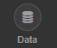
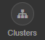
Secure Collaboration
Azure Databricks enables secure collaboration between colleagues
With Azure Databricks colleagues can securely share key artifacts such as Clusters, Notebooks, Jobs and Workspaces
Secure collaboration is enabled through a combination of:
Fine grained permissions: Defines who can do what on which artifacts (access control)
AAD-based authentication: Ensures that users are actually who they claim to be
Fine Grained Permissions
AAD-based User Authentication

Slide 28


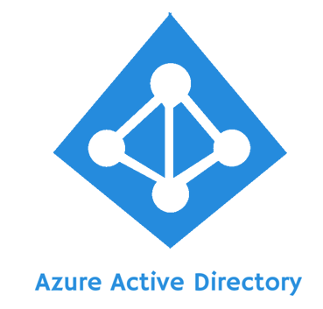
Azure Databricks Integration with AAD
Azure Databricks is integrated with AAD—so Azure Databricks users are just regular AAD users
There is no need to define users—and their access control—separately in Databricks.
AAD users can be used directly in Azure Databricks for all user-based access control (Clusters, Jobs, Notebooks etc.).
Databricks has delegated user authentication to AAD enabling single-sign on (SSO) and unified authentication.
Notebooks, and their outputs, are stored in the Databricks account. However, AAD-based access-control ensures that only authorized users can access them.
Access
Control
Authentication
Azure Databricks

Slide 29
Databricks Access Control
Access control can be defined at the user level via the Admin Console
Access Control can be defined for Workspaces, Clusters, Jobs and REST APIs
Workspace Access Control | Defines who can who can view, edit, and run notebooks in their workspace
Cluster Access Control | Allows users to who can attach to, restart, and manage (resize/delete) clusters. Allows Admins to specify which users have permissions to create clusters
Jobs Access Control | Allows owners of a job to control who can view job results or manage runs of a job (run now/cancel)
REST API Tokens | Allows users to use personal access tokens instead of passwords to access the Databricks REST API
Databricks Access
Control

Slide 30




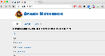
Azure Databricks Core ARTIFACTS
Clusters
Libraries
Workspaces
Azure Databricks
Jobs
Notebooks

Slide 31
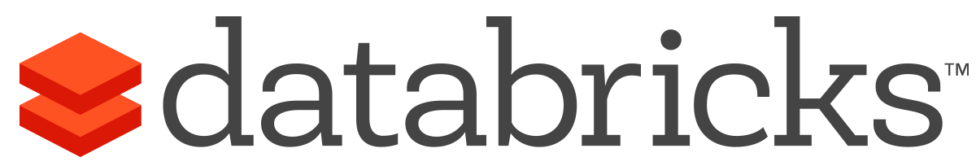


What is Azure Databricks?
A fast, easy and collaborative Apache® Spark™ based analytics platform optimized for Azure
Best of Databricks
Best of Microsoft
Designed in collaboration with the founders of Apache Spark
One-click set up; streamlined workflows
Interactive workspace that enables collaboration between data scientists, data engineers, and business analysts.
Native integration with Azure services (Power BI, SQL DW, Cosmos DB, Blob Storage)
Enterprise-grade Azure security (Active Directory integration, compliance, enterprise-grade SLAs)
Notes:
Azure Databricks features –
Enhance your teams’ productivity
Get started quickly by launching your new Spark environment with one click.
Share your insights in powerful ways through rich integration with PowerBI.
Improve collaboration amongst your analytics team through a unified workspace.
Innovate faster with native integration with rest of Azure platform.
Build on the most compliant and trusted cloud
Simplify security and identity control with built-in integration with Active Directory.
Regulate access with fine-grained user permissions to Azure Databricks’ notebooks, clusters, jobs and data.
Build with confidence on the trusted cloud backed by unmatched support, compliance and SLAs.
Scale without limits
Operate at massive scale without limits globally.
Accelerate data processing with the fastest Spark engine.

Slide 32



Azure Databricks key audiences & benefits
Data scientist
Data engineer
CDO, VP of analytics
Integrated workspace
Easy data exploration
Collaborative experience
Interactive dashboards
Faster insights
Best Spark & serverless
Databricks managed Spark
Improved ETL performance
Zero management clusters, serverless
Easy to schedule jobs
Automated workflows
Enhanced monitoring & troubleshooting
Automated alerts & easy access to logs
Zero Management Spark
Cluster democratization (serverless)
Fast, collaborative analytics platform accelerating time to market
No dev-ops required
Enterprise grade security
Encryption
End-to-end auditing
Role-based control
Compliance
Unified analytics platform
Provided by Microsoft and Databricks under NDA

Slide 33
Advanced Analytics on Big Data
Ingest
Store
Prep & Train
Model & Serve
Intelligence
Logs, files and media (unstructured)
Data factory
Azure storage
Azure Databricks
(Spark Mllib, SparkR, SparklyR)
Azure Cosmos DB
Web & mobile apps
Business / custom apps
(Structured)
Polybase
Data factory
Azure SQL Data Warehouse
Analytical dashboards

Slide 34
Demo

Slide 35

It’s Time for a Closer Look

Slide 36
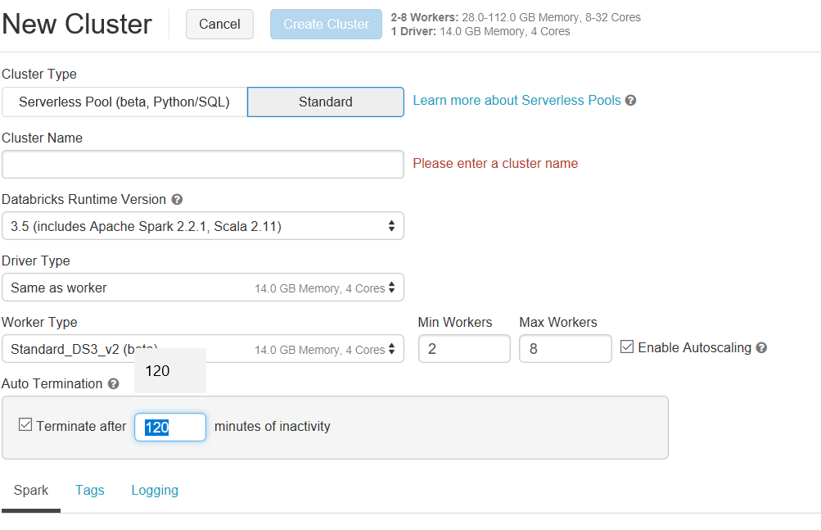
Compute and Storage are Separate

Slide 37
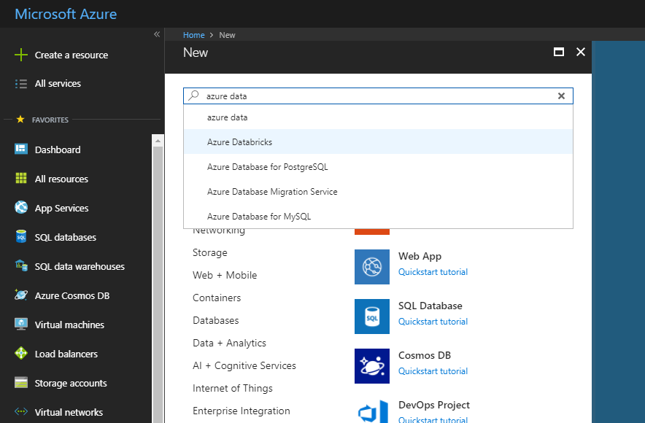
Azure Databricks – service home page
Search for Resource

Slide 38
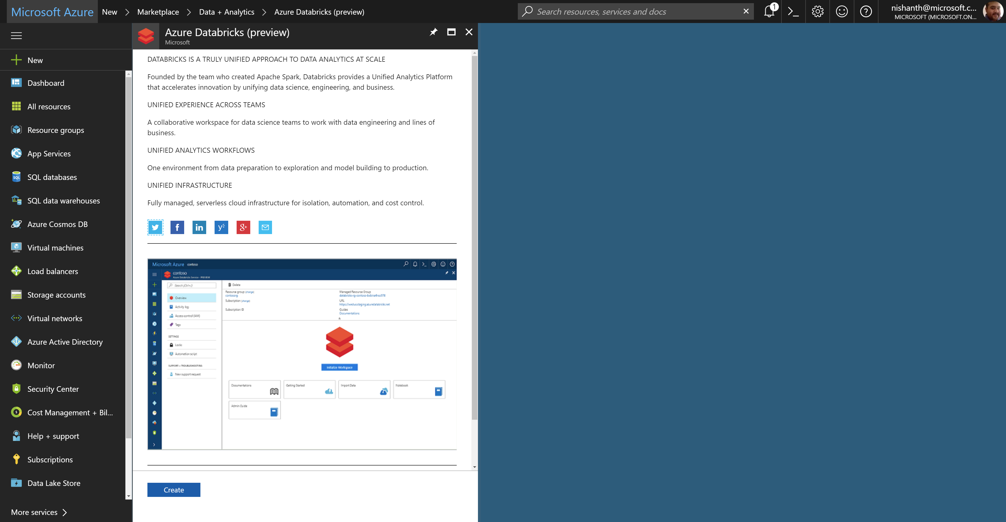
Azure Databricks – service home page

Slide 39
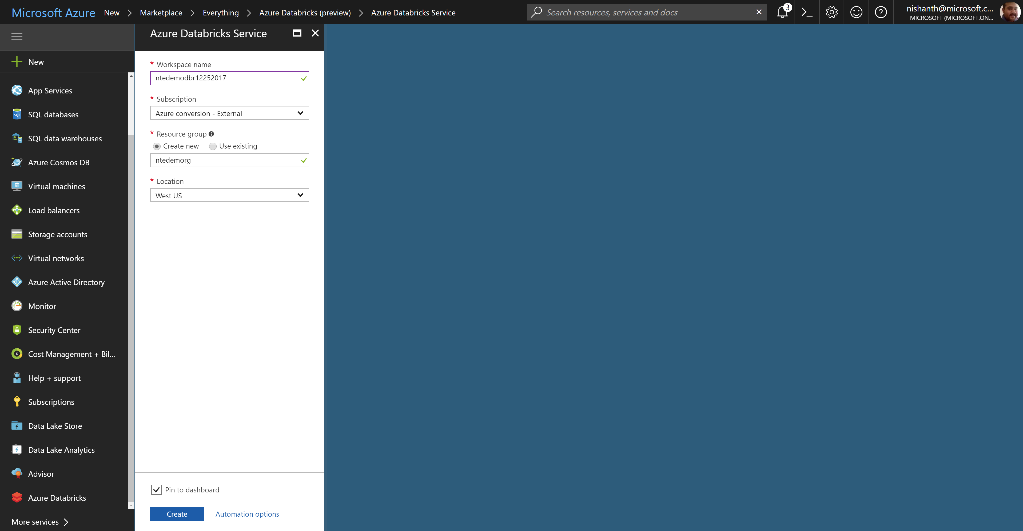
Azure Databricks – creating a workspace

Slide 40
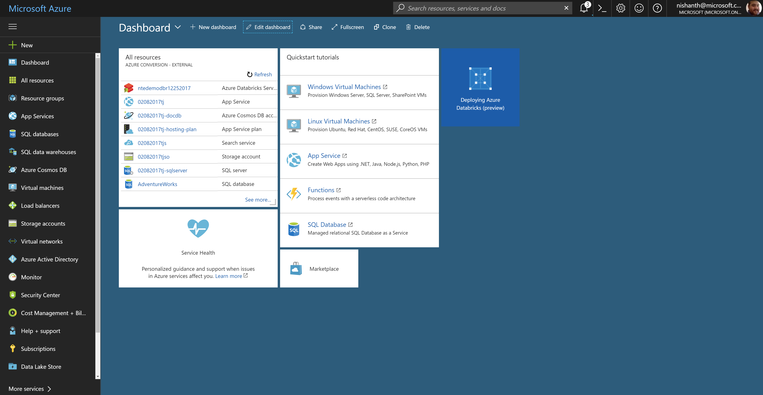
Azure Databricks – workspace deployment

Slide 41
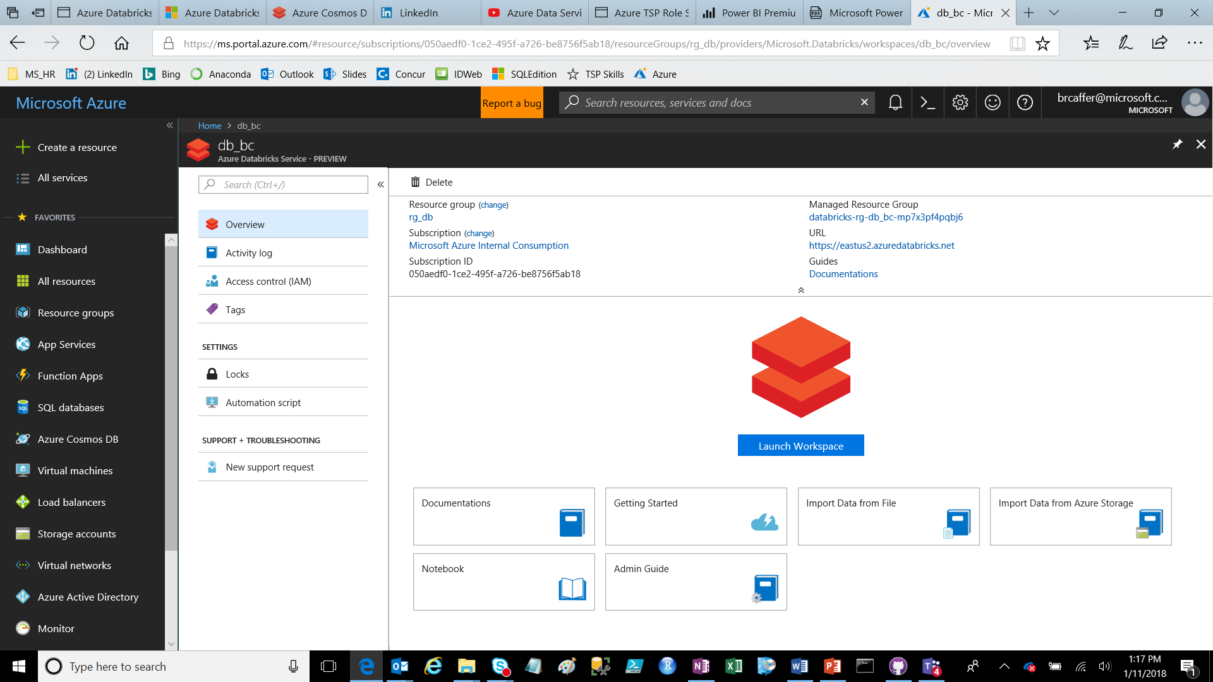
Help All Along the Way
Documentation
Quick Start

Slide 42
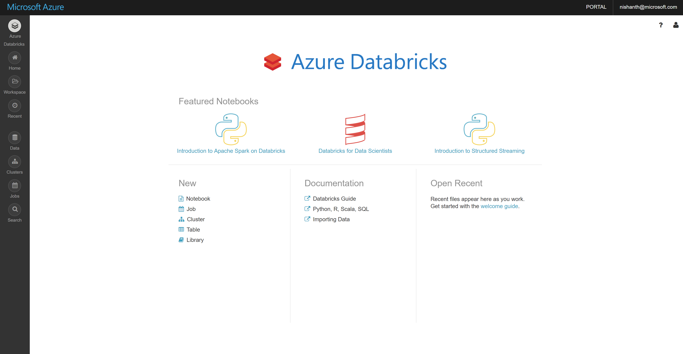
Azure Databricks – workspace home page

Slide 43

A Deeper Dive

Slide 44

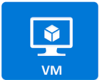
Clusters
Azure Databricks clusters are the set of Azure Linux VMs that host the Spark Worker and Driver Nodes
Your Spark application code (i.e. Jobs) runs on the provisioned clusters.
Azure Databricks clusters are launched in your subscription—but are managed through the Azure Databricks portal.
Azure Databricks provides a comprehensive set of graphical wizards to manage the complete lifecycle of clusters—from creation to termination.

Slide 45
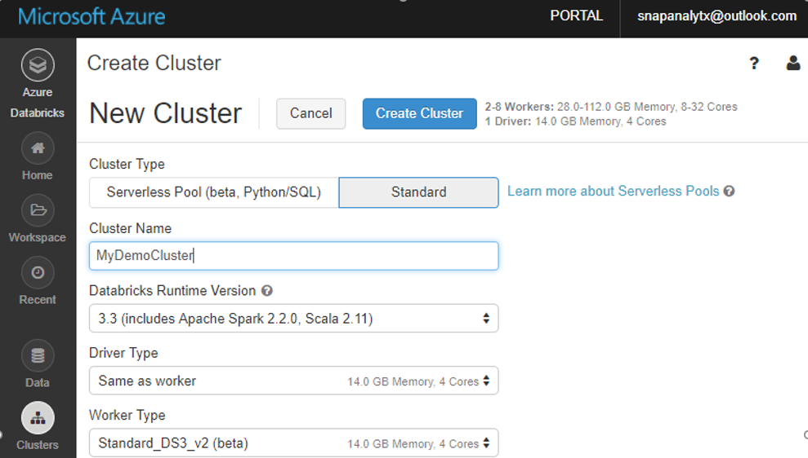
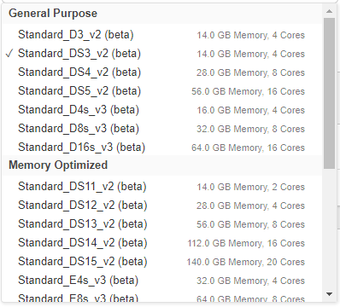
Cluster Creation
You can create two types of clusters – Standard and Serverless Pool (see next slide)
While creating a cluster you can specify:
Number of nodes
Autoscaling and Auto Termination policy
Auto Termination policy
Spark Configuration details
The Azure VM instance types for the Driver and Worker Nodes
Graphical wizard in the Azure Databricks portal to create a Standard Cluster

Slide 46
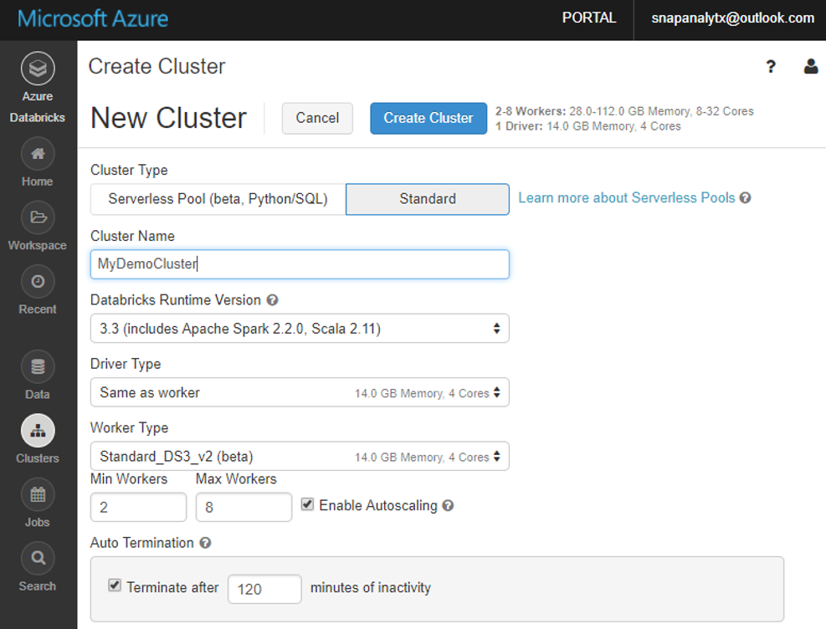
Clusters: Auto Scaling and Auto Termination
Simplifies cluster management and reduces costs by eliminating wastage
When creating Azure Databricks clusters you can choose Autoscaling and Auto Termination options.
Autoscaling: Just specify the min and max number of clusters. Azure Databricks automatically scales up or down based on load.
Auto Termination: After the specified minutes of inactivity the cluster is automatically terminated.
Benefits:
You do not have to guess, or determine by trial and error, the correct number of nodes for the cluster
As the workload changes you do not have to manually tweak the number of nodes
You do not have to worry about wasting resources when the cluster is idle. You only pay for resource when they are actually being used
You do not have to wait and watch for jobs to complete just so you can shutdown the clusters

Slide 47
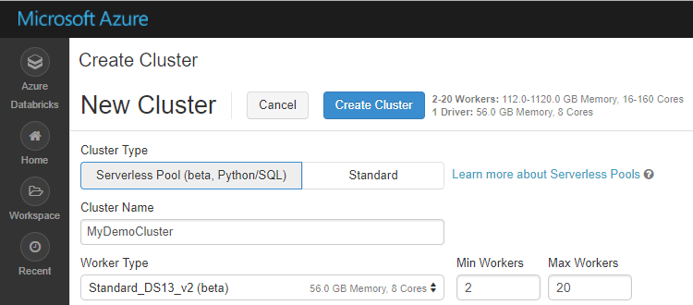
Serverless Pool (Beta)
A self-managed pool of cloud resources, auto-configured for interactive Spark workloads
You specify only the minimum and maximum number of nodes in the cluster—Azure Databricks provisions and adjusts the compute and local storage based on your usage.
Limitation: Currently works only for SQL and Python.
Benefits of Serverless Pool
Auto-Configuration | Databricks chooses the best configuration for Spark to get the best performance Users don’t need to worry about providing any of the Databricks runtime version or Spark configuration. Databricks also chooses the best cluster parameters to save cost on infrastructure
Elasticity | Automatically scales the compute and local storage, independently, based on usage
Fine grained Sharing | Offers maximum resource utilization and minimum query latencies Preemption: Databricks proactively preempts Spark tasks from over-committed users to ensure all users get their fair share of cluster time and their jobs complete in a timely manner even when contending with dozens of other users. Uses the “Task Preemption for High Concurrency” feature of Spark in Databricks. Fault isolation: Databricks sandboxes the environments belonging to different notebooks from one another.

Slide 48
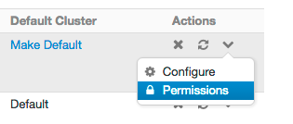
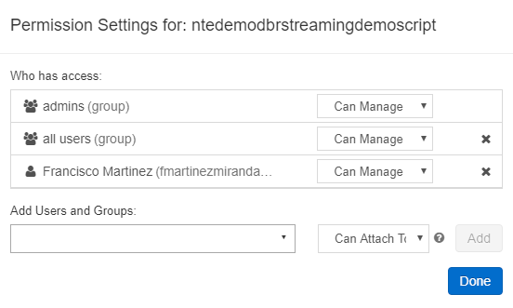
Cluster Access Control
There are two configurable types of permissions for Cluster Access Control:
Individual Cluster Permissions - This controls a user’s ability to attach notebooks to a cluster, as well as to restart/resize/terminate/start clusters.
Cluster Creation Permissions - This controls a user’s ability to create clusters
Individual permissions can be configured on the Clusters Page by clicking on Permissions under the ‘More Actions’ icon of an existing cluster
There are 4 different individual cluster permission levels: No Permissions, Can Attach To, Can Restart, and Can Manage. Privileges are shown below
Abilities | No Permissions | Can Attach To | Can Restart | Can Manage
Attach notebooks to cluster |  | x | x | x
View Spark UI |  | x | x | x
View cluster metrics (Ganglia) |  | x | x | x
Terminate cluster |  |  | x | x
Start cluster |  |  | x | x
Restart cluster |  |  | x | x
Resize cluster |  |  |  | x
Modify permissions |  |  |  | x
Tom Smith (tom@company.com)

Slide 49
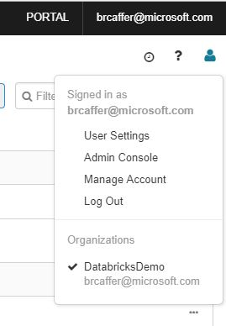
Administration

Slide 50
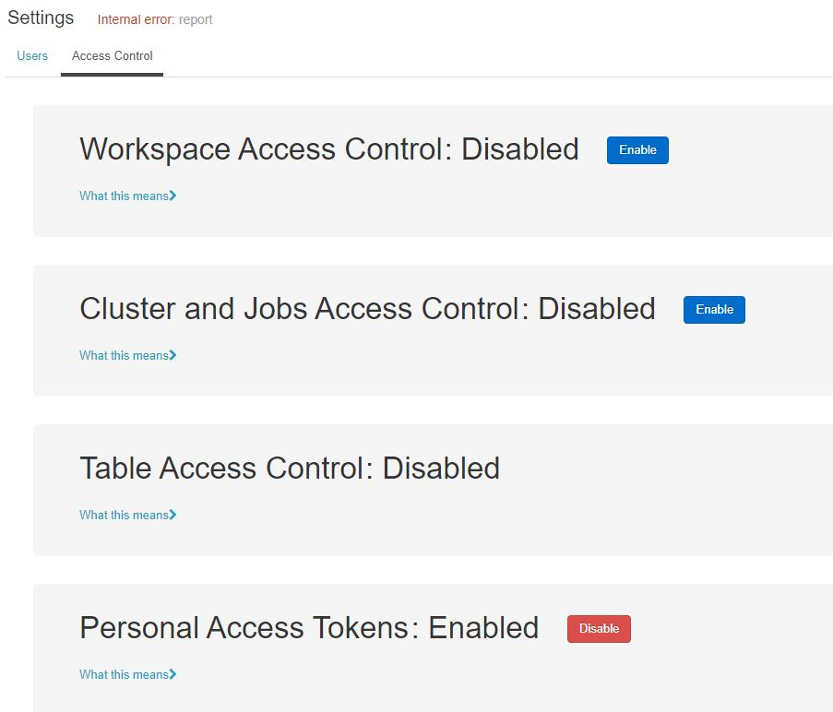
Administration Settings
What do you want to restrict?

Slide 51
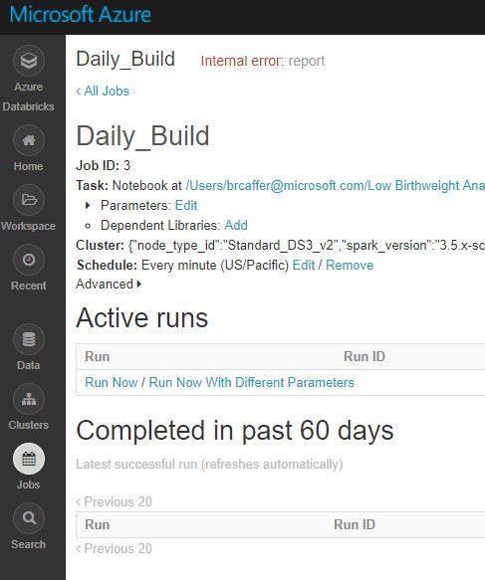
Job – Advanced Settings

Slide 52
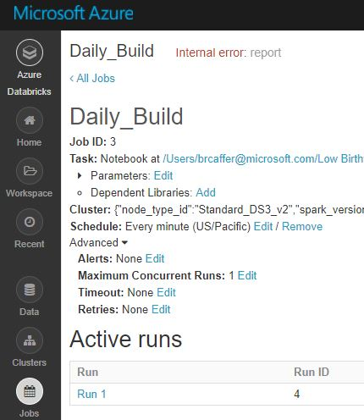
Job Advanced Settings

Slide 53
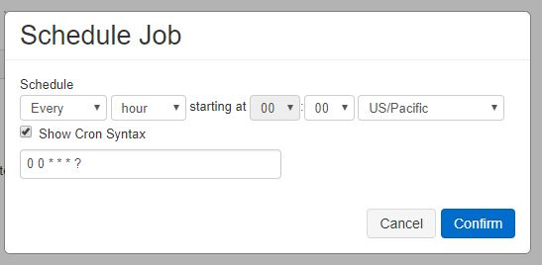
Job Schedule – CRON Format Support

Slide 54
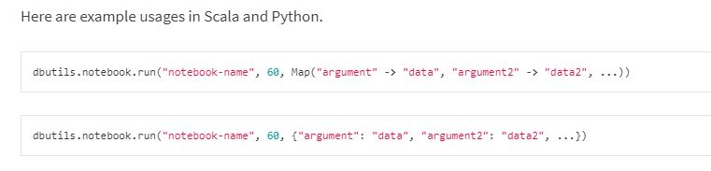
Calling Other Notebooks

Slide 55
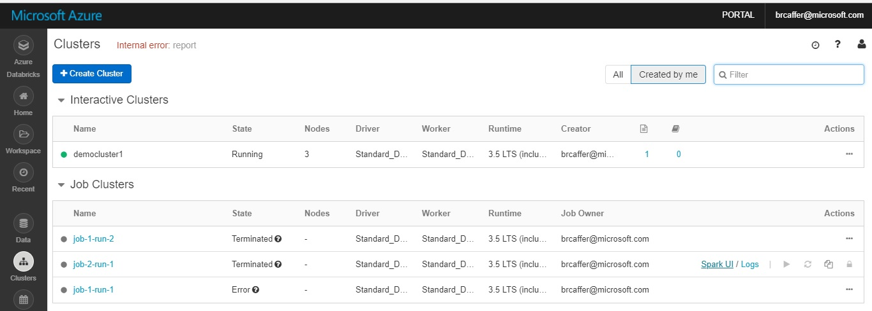
Getting to the Spark Console
Spark GUI

Slide 56
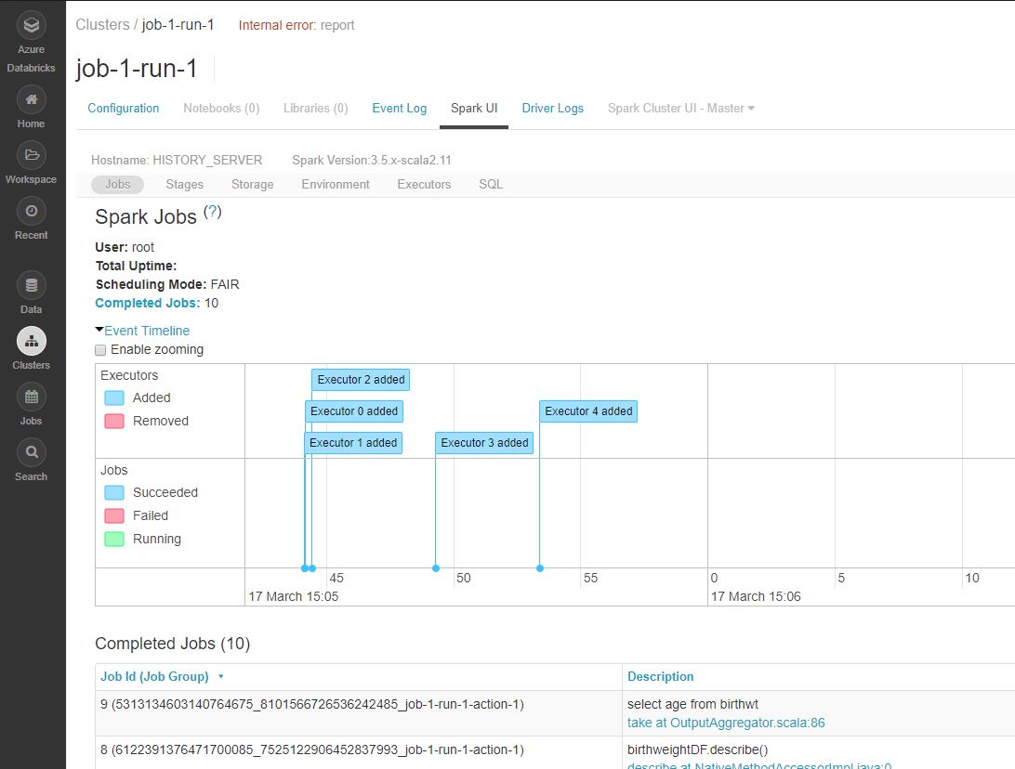
Spark Job Metrics

Slide 57
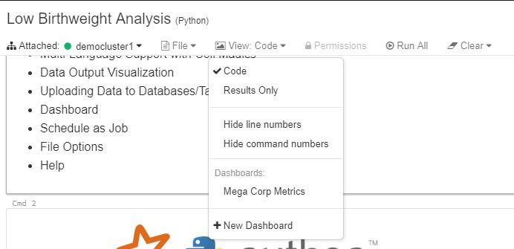
Dashboard
Show Existing
New Dashboard

Slide 58
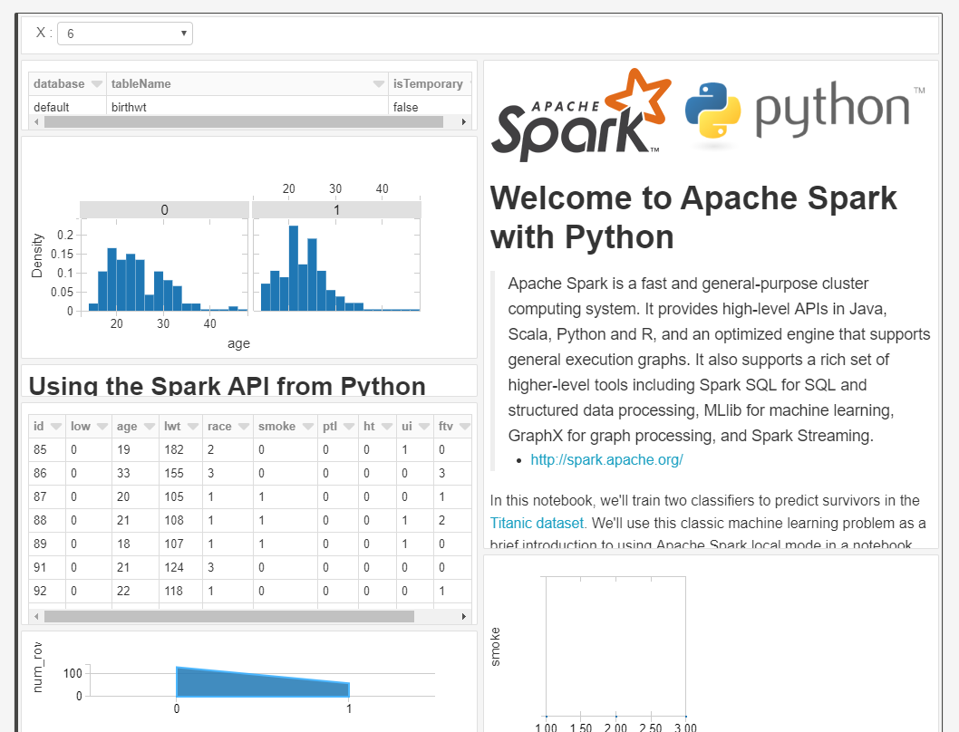
Dashboard

Slide 59


Widgets
Widget Settings

Slide 60

Dynamic Visualizations with Widgets

Slide 61

Wrapping Up

